Slide 1
Urban ParkiNG INTELLIGENCE Dashboard
BY:
MOHITHA.B

Slide 2
INTRODUCTION:
The Urban Parking Analytics Dashboard is designed to analyze parking data using Power BI.
It provides a clear view of parking usage, vehicle activity, waiting time, revenue, and customer ratings.
The dashboard helps understand parking trends and supports better parking management and data-driven decision-making.
PROBLEM STATEMENT:
To Analyze the parking congestion,revenue,waiting time and Demand.

Slide 3
Tools Used:
Power BI: Used to create the interactive dashboard and visualizations.
Power Query: Used to clean, transform, and prepare the parking data.
Microsoft Excel: Used to store and organize the raw dataset.
DAX: Used to create calculations, measures, and KPIs.
DATASET OVERVIEW:
The dataset contains urban parking information such as vehicle details, parking zones, parking lots, entry time, and parking duration.
It also includes parking fees, payment methods, weather conditions, and customer ratings.
The dataset is used to analyze parking demand, revenue, vehicle activity, and customer satisfaction.

Slide 4
DATA CLEANING AND PROCESSING:
Data Collection.
Removing Duplicates .
Handling Missing Values.
Correcting Data Types.
Removing Unnecessary Data.
Data Validation.
Loading into Power BI.

Slide 5
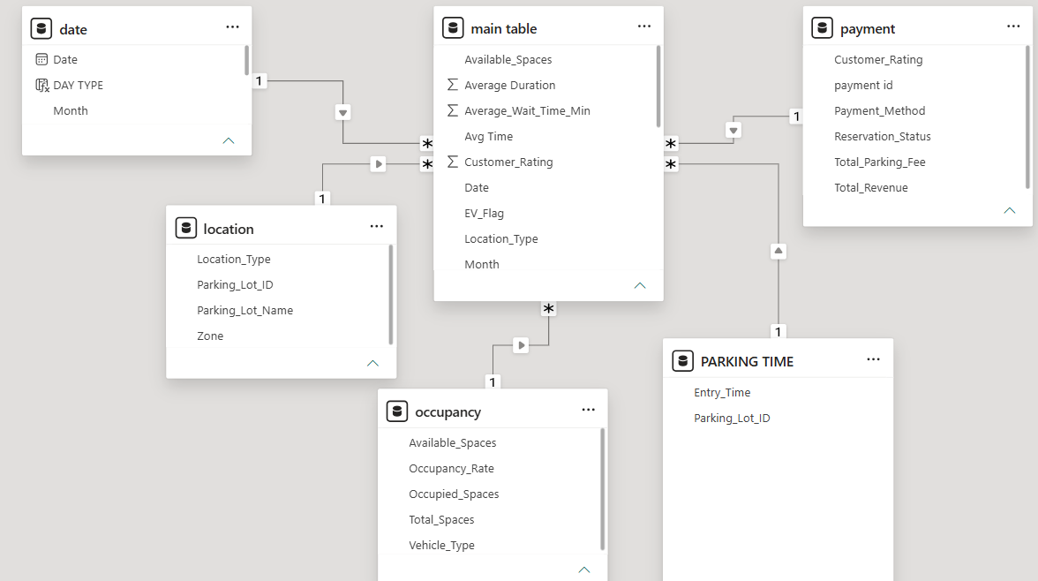
STAR SCHEMA:
I used a Star Schema in my project to organize the data in Power BI.
Fact Table – Stores the main parking transaction data.
Dimension Tables – Store details like Date, Vehicle,
Location, and Customer.
The Fact Table is in the center and the Dimension Tables
are connected to it.
This helps to analyze the data easily and create dashboards.

Slide 6





OVERVIEW KPI’S:

Slide 7
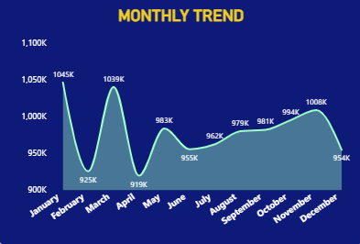
MONTHLY TREND:
X-axis: Months from January to December.
Y-axis: Monthly value, ranging from approximately 900K to 1,100K.
The value is highest in January (1,045K) and reaches another high in March (1,039K).
The lowest value is in April (919K).
After April, the trend generally increases and reaches 1,008K in November, before decreasing to 954K in December.

Slide 8
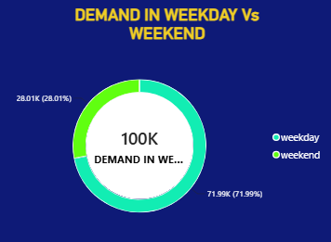
DEMAND IN WEEKDAYS & WEEKEND:
Categories: Weekday and Weekend.
Values: Weekday demand is 71.99K (71.99%), while Weekend demand is 28.01K (28.01%).
Total Demand: The chart shows a total demand of approximately 100K.
The chart indicates that demand is higher on weekdays compared with weekends.

Slide 9
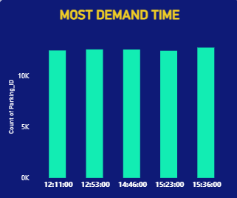
MOST DEMAND TIME:
The X-axis represents the time of day, while the Y-axis represents the count of ride requests.
The chart shows that demand is consistently high, with all times recording more than 10K requests.
The highest demand occurs around 15:36:00, while the other times have very similar demand levels.

Slide 10
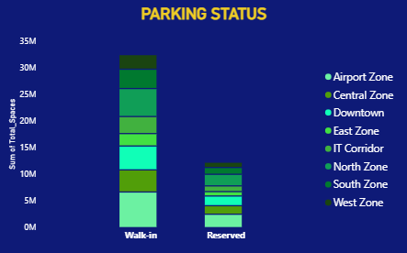
PARKING STATUS:
The X-axis shows the parking status as Walk-in and Reserved, while the Y-axis represents the sum of total parking spaces in millions (M).
The chart shows that Walk-in parking has significantly more spaces than Reserved parking, with Walk-in reaching about 32M spaces.
The parking spaces are divided among different zones, including Airport, Central, Downtown, East, IT Corridor, North, South, and West Zones.

Slide 11
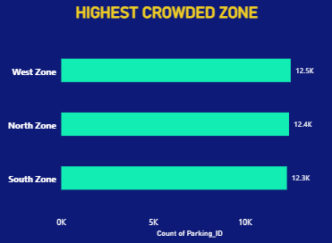
HIGHEST CROWDED ZONE:
The X-axis represents the Count of Parking_ID, while the Y-axis shows different parking zones.
The West Zone has the highest crowding with 12.5K parking requests, followed by the North Zone (12.4K).
The South Zone has the lowest among the three, with approximately 12.3K parking requests.

Slide 12
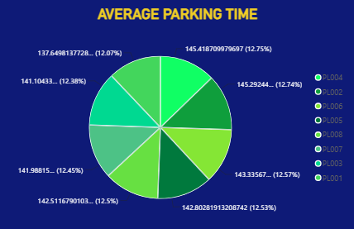
AVERAGE PARKING TIME:
The pie chart shows the average parking time for different parking locations (PLO04, PLO02, PLO06, PLO05, PLO08, PLO07, PLO03, and PLO01).
Each location contributes almost equally, with average parking times ranging from about 137.6 to 145.4 minutes.
The highest average parking time is approximately 145.4 minutes (12.75%), while the lowest is about 137.6 minutes (12.07%).

Slide 13




CUSTOMER & REVENUE KPI’S:

Slide 14
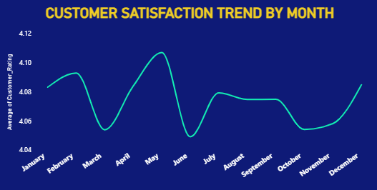
CUSTOMER SATISFACTION BY TREND:
The X-axis represents the months from January to December, while the Y-axis shows the average customer rating.
Customer satisfaction reaches its highest point in May, at approximately 4.11, and its lowest point in June, at around 4.05.
Overall, customer satisfaction remains consistently high throughout the year, with some fluctuations between months.

Slide 15
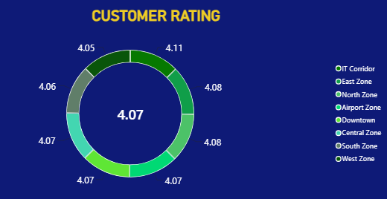
CUSTOMER RATING:
The doughnut chart shows the customer rating across different parking zones, with an overall average rating of 4.07 displayed in the center.
The ratings for the zones are very similar, ranging from approximately 4.05 to 4.11, indicating consistently high customer satisfaction.
The highest rating is 4.11, while the lowest rating is 4.05, showing only a small variation between zones.

Slide 16
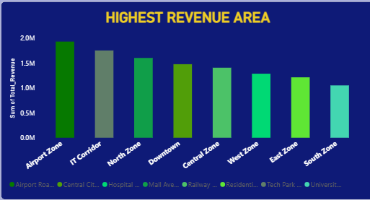
HIGHEST REVENUE AREA:
The X-axis represents different revenue areas, while the Y-axis shows the sum of total revenue in millions (M).
The Airport Zone generates the highest revenue at approximately 1.9M, followed by the IT Corridor at around 1.7M.
The South Zone has the lowest revenue at about 1.0M, showing that revenue varies across the different zones.

Slide 17
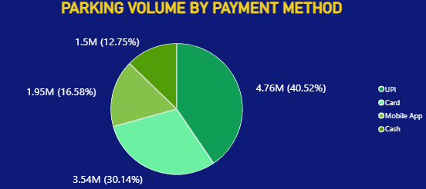
PARKING VOLUME BY PAYMENT METHOD:
The pie chart shows the parking volume by different payment methods, with
UPI having the highest volume at 4.76M (40.52%).
Card accounts for 3.54M (30.14%),
Mobile App contributes 1.95M (16.58%).
Cash has the lowest parking volume at 1.5M (12.75%).
That digital payments are more commonly used.

Slide 18


VEHICLE ANALYSIS KPI’S:

Slide 19
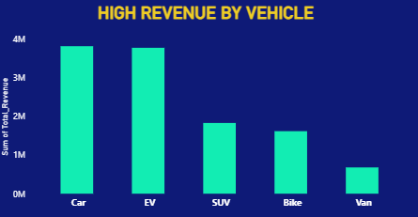
HIGH REVENUE VEHICLE:
The X-axis represents different vehicle types—Car, EV, SUV, Bike, and Van—while the Y-axis shows the sum of total revenue in millions (M).
Cars and EVs generate the highest revenue at around 3.8M, followed by SUVs (1.8M) and Bikes (1.6M).
Vans generate the lowest revenue at approximately 0.7M, showing that cars and EVs contribute the most to total revenue.

Slide 20
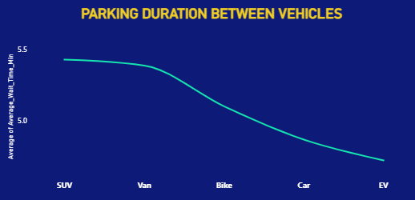
PARKING DURATION BETWEEN VEHICLE:
The X-axis represents different vehicle types—SUV, Van, Bike, Car, and EV—while the Y-axis shows the average parking duration in minutes.
SUVs have the longest average parking duration at about 5.4 minutes, followed by Vans and Bikes.
EVs have the shortest parking duration at approximately 4.7 minutes, showing a decreasing trend in parking time across the vehicle types.

Slide 21
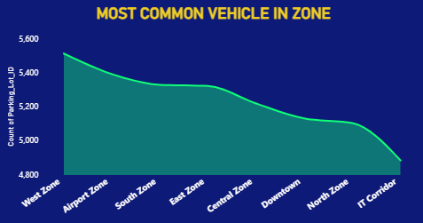
COMMON VEHICLE IN ZONE :
The X-axis represents different zones while the
Y-axis shows the Count of Parking_ID.
The West Zone has the highest number of parking
records at approximately 5,500, followed by the
Airport Zone.
The IT Corridor has the lowest count at around
4,900, showing a gradual decrease in parking
activity across the zones.

Slide 22
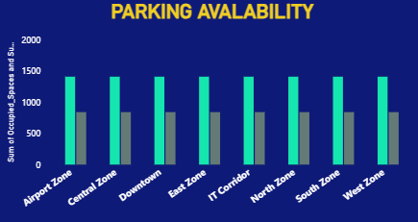
PARKING AVALABILITY:
The X-axis represents different parking zones, while the Y-axis shows the sum of occupied spaces and available spaces.
The occupied spaces are around 1,400, while the available spaces are approximately 850.
The chart shows that parking occupancy is relatively consistent across all zones, with slightly higher occupancy than availability in each zone.

Slide 23
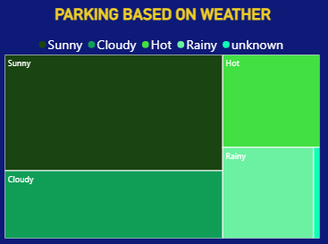
PARKING BASED ON WEATHER:
The treemap chart shows parking activity under different weather conditions: Sunny, Cloudy, Hot, Rainy, and Unknown.
Sunny weather has the largest parking volume, followed by Cloudy and Hot conditions.
Rainy and Unknown conditions have smaller parking volumes, indicating that parking activity is highest during Sunny weather.

Slide 24
CONCLUSION:
The Urban Parking Dashboard helps to analyze parking data in a simple and clear way.
It shows important information such as parking usage, revenue, vehicle details, and parking trends.
The dashboard helps users understand the data and make better decisions for efficient parking management.

Slide 25


